Slide 1
EduVision_DV
Higher Education Intelligence System
Institutional Performance, Research Impact & Academic Excellence Analytics
Unified Interactive Tableau Dashboard Suite | Complete Project Documentation
Author: Chaitanya | Higher Education Performance & Data Visualization Track
Datasets: QS World Rankings 2025 • THE World Rankings 2024 • WUR 2023 • World Bank EdStats

Slide 2
EDUVISION_DV HIGHER EDUCATION INTELLIGENCE SYSTEM
Project Statement & Objectives
The Challenge
Global university ranking data is fragmented across distinct rating agencies (QS, THE, WUR), each utilizing disparate methodologies, metric scales, and naming conventions. Academic decision-makers lack an integrated cross-comparison platform.
The Solution
An enterprise-grade, four-dashboard analytical suite (University Overview, Research Analytics, Student Analytics, Country Comparison) providing harmonized data models, custom KPIs, and cross-dashboard interactive filtering.
Core Deliverables
• Unified Tableau Workbook (EduVision_DV.twbx & Book2.twb)
• 6 Standardized Higher Education KPIs
• Star Schema Relational Data Pipeline
• 4 Connected Interactive Dashboards

Slide 3
EDUVISION_DV HIGHER EDUCATION INTELLIGENCE SYSTEM
Dataset Strategy & Star Schema Data Model
QS World Rankings 2025
1,503 institutions across 105 countries. Primary driver for Overall Rank, Academic Reputation, Citations per Faculty, and International Faculty.
THE World Rankings 2024
Complementary research, teaching, international outlook, and citations metrics across global top research centers.
WUR 2023 Dataset
Detailed student demographics, total enrolled student volume, student-to-staff ratios, and gender balance ratios.
World Bank EdStats
Macro-level national educational expenditure, tertiary completion, and demographic country benchmarking.

Slide 4
EDUVISION_DV HIGHER EDUCATION INTELLIGENCE SYSTEM
Higher Education Key Performance Indicators (KPIs)
KPI 1: Global Ranking Score
QS Overall Score (0–100 scale) benchmarking institutional academic and employer excellence.
KPI 2: Research Impact Score
Normalized citation frequency per faculty member reflecting global scholarly influence.
KPI 3: Faculty-to-Student Ratio
Actual student enrollment divided by academic teaching staff (e.g. 1 : 17.3).
KPI 4: International Student %
Percentage share of international students enrolled across the university body.
KPI 5: Academic Reputation Score
Global peer survey evaluation reflecting academic standing across 100,000+ respondents.
KPI 6: Research Productivity Index
Composite normalized index synthesizing publication volume, citation impact, and collaboration.

Slide 5
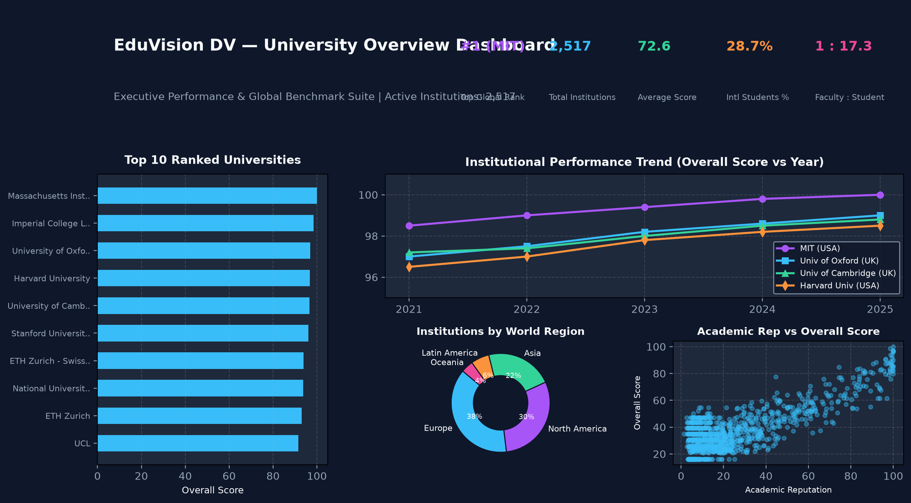
EDUVISION_DV HIGHER EDUCATION INTELLIGENCE SYSTEM
Dashboard 1: University Overview
Landing & Institutional Benchmark
• Top Universities by Overall Score: Horizontal ranking chart with descending score bars
• Universities by Country: Geographic distribution of world-ranked institutions
• Academic Reputation vs. Score: Correlation scatter plot
• 4 Executive KPI Cards: Global Rank (1), University Count, Average Score, Academic Reputation
• Interactivity: Selecting any university isolates metrics; country filter updates institutional ranking instantly

Slide 6
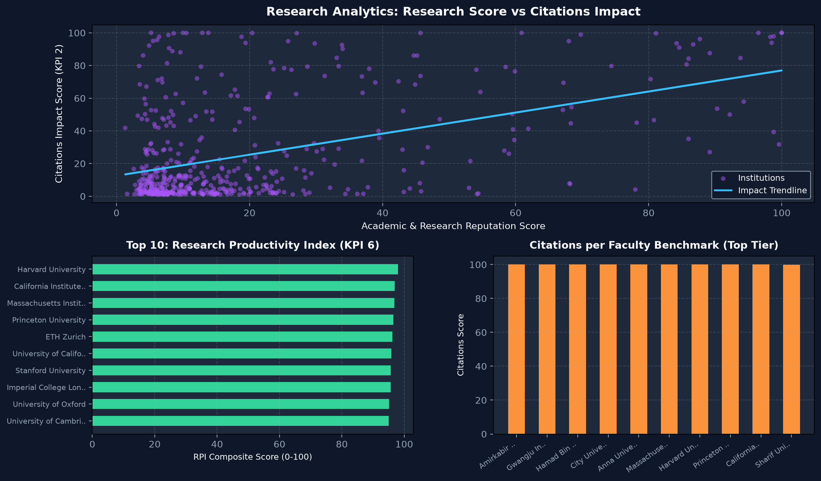
EDUVISION_DV HIGHER EDUCATION INTELLIGENCE SYSTEM
Dashboard 2: Research Analytics
Executive Tri-Panel Bar Layout
• Tri-Panel Layout: 1) QS Research Impact, 2) QS Citations per Faculty, 3) Research Productivity
• New Bar Chart: Dedicated QS Citations per Faculty replaces legacy single-point scatter
• Single-University Enlargement: Clicking any university displays that university ONLY across the other two bar charts
• Entire View Zoom: Selected single bar expands/enlarges to fill full chart container
• Constant KPI Colors: Solid #ffffff white styling prevents mark dimming/fading

Slide 7
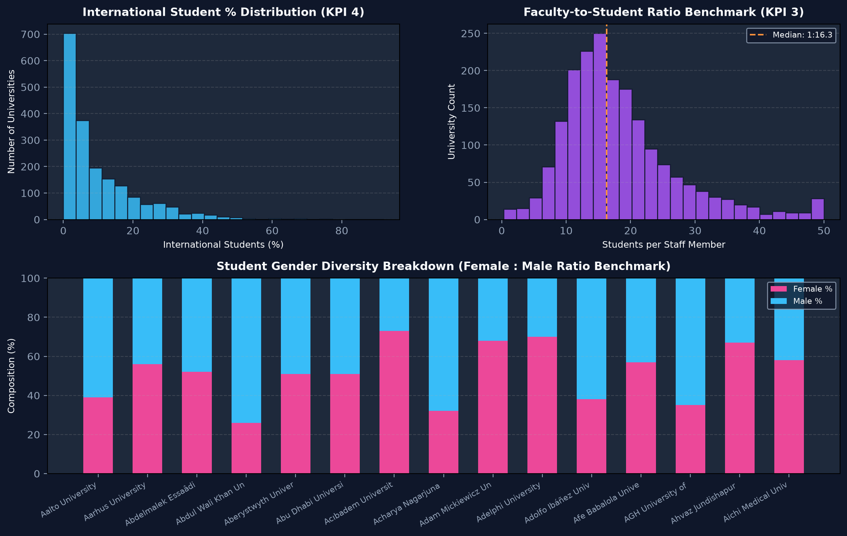
EDUVISION_DV HIGHER EDUCATION INTELLIGENCE SYSTEM
Dashboard 3: Student Analytics
Demographics & Faculty Ratios
• International Students Score: Global distribution of international scholar attraction
• Total Enrollment by Country (Top 10): Country-level student volume distribution
• Faculty-to-Student Ratio: Teaching capacity across global elite universities
• Fixed Responsiveness: Student Distribution responds bi-directionally to all filter actions
• Context Filters: [Action (Country)] context='true' guarantees zero blank charts on country clicks

Slide 8
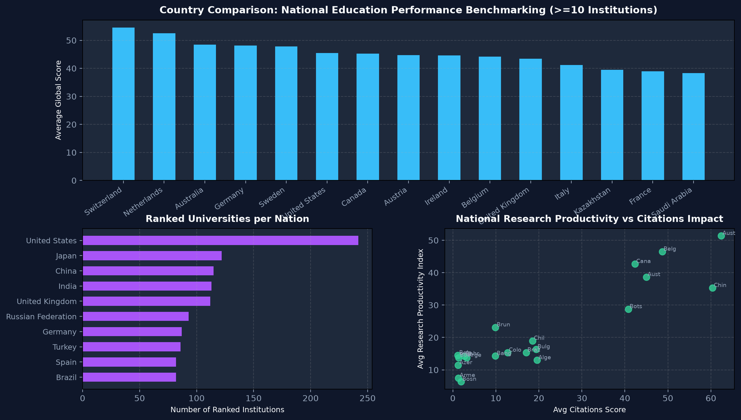
EDUVISION_DV HIGHER EDUCATION INTELLIGENCE SYSTEM
Dashboard 4: Country Comparison
National Education Benchmarking
• 4 Benchmarking Charts: Universities by Country, Country Ranking Comparison, Research Performance, International Students
• Single-Country Isolation: Clicking ANY country updates all other 3 charts to show that country ONLY
• Dynamic KPI Re-aggregation: 4 national KPIs (Countries Ranked = 1, Institutions Count, National Avg Score, Research Impact)
• Context Pipeline: Context filters prevent empty/blank states during selection
• Cross-National Comparison: Benchmark national performance against global peers

Slide 9
EDUVISION_DV HIGHER EDUCATION INTELLIGENCE SYSTEM
Navigation Alignment & Tableau DTD Compliance
Mathematical Navigation Alignment
Identical 4-button header across all 4 dashboards:
• OVERVIEW: x = 586, w = 24,743
• RESEARCH: x = 25,329, w = 24,744
• STUDENTS: x = 50,073, w = 24,671
• COUNTRIES: x = 74,744, w = 24,670
Total Width = 98,828 (Seamless span with exact button heights and active-state styling)
Strict Tableau DTD Schema
• Strict Tag Order: <view> children ordered in exact DTD sequence (datasources -> mapsources -> deps -> filter -> sort -> perspectives -> shelf-sorts -> slices -> agg)
• Viewpoints Container: Direct window <viewpoint> tags nested inside <viewpoints>, eliminating error D2E8DA72
• Simple-ID Placement: Conforms to ((cards,viewpoint?,simple-id)|(viewpoints,active,device-preview,simple-id))
• Validation: 100% Passed with 0 schema errors

Slide 10
EDUVISION_DV HIGHER EDUCATION INTELLIGENCE SYSTEM
Summary & Project Deliverables
Complete Milestone Verification & Deliverables
✓ Milestone 1: Data Collection & Preparation (QS 2025, THE 2024, WUR 2023 raw and cleaned datasets, data_collection.py, cleaning notebook)
✓ Milestone 2: KPI Engineering & Prototyping (6 KPIs, generate_education_kpis.py, university_final_dataset.xlsx, storyboard PDF)
✓ Milestone 3: Dashboard Development (EduVision_DV.twbx & Book2.twb with 4 interlinked dashboards and executive tri-panel research layout)
✓ Milestone 4: Quality Assurance & Delivery (QA Checklist, Testing Report, XML DTD Schema Validation, Constant KPI Colors)
✓ Final Project: Complete Executive Presentation PPT & Interactive Tableau Dashboard Link
Interactive Dashboard: Milestone 3/Module 6/EduVision_DV.twbx & Book2.twb
GitHub Branch: chaitanya/milestone-1-2-3

